Slide 1
Week 11 MVP – Chess AI using ML
By Kuzey

Slide 2
Project Goals
Develop a Chess AI.
Use Machine Learning.
Train with self-play.
Create an AI strong enough to beat me and my supervisors. ☺
Improve myself by learning in depth AI and Machine Learning.
Force my self out of my comfort zone by doing a hard project.

Slide 3
Approach
Inspired by AlphaZero – DeepMind Google.
Read Papers.
Researched websites.
Studied modules.
Looked through libraries
Researched decision theory.
Researched game tree.
Learned different strategies for writing a game AI.

Slide 4
Work Done / Difficulties
Work Done
Minimax
Alpha-beta pruning
Transposition table
Iterative deepening
Move ordering
Zobrist Hashing
Strong evaluation function
Playable as both colours
Reset Game
Depth Selection
AI vs AI
Player vs AI
Player vs Player
Difficulties
Monte Carlo Tree Search
Evaluation Function
Flask
Efficiency Methods

Slide 5
Tools/Software Used
Python, JS, HTML, CSS
Python-chess – Backend strong chess library
Chessboard.js – Frontend chess visuals
Flask – Backend for sending data from python-chess to chessboard.js
jQuery – Used by chessboard.js
VS Code

Slide 6
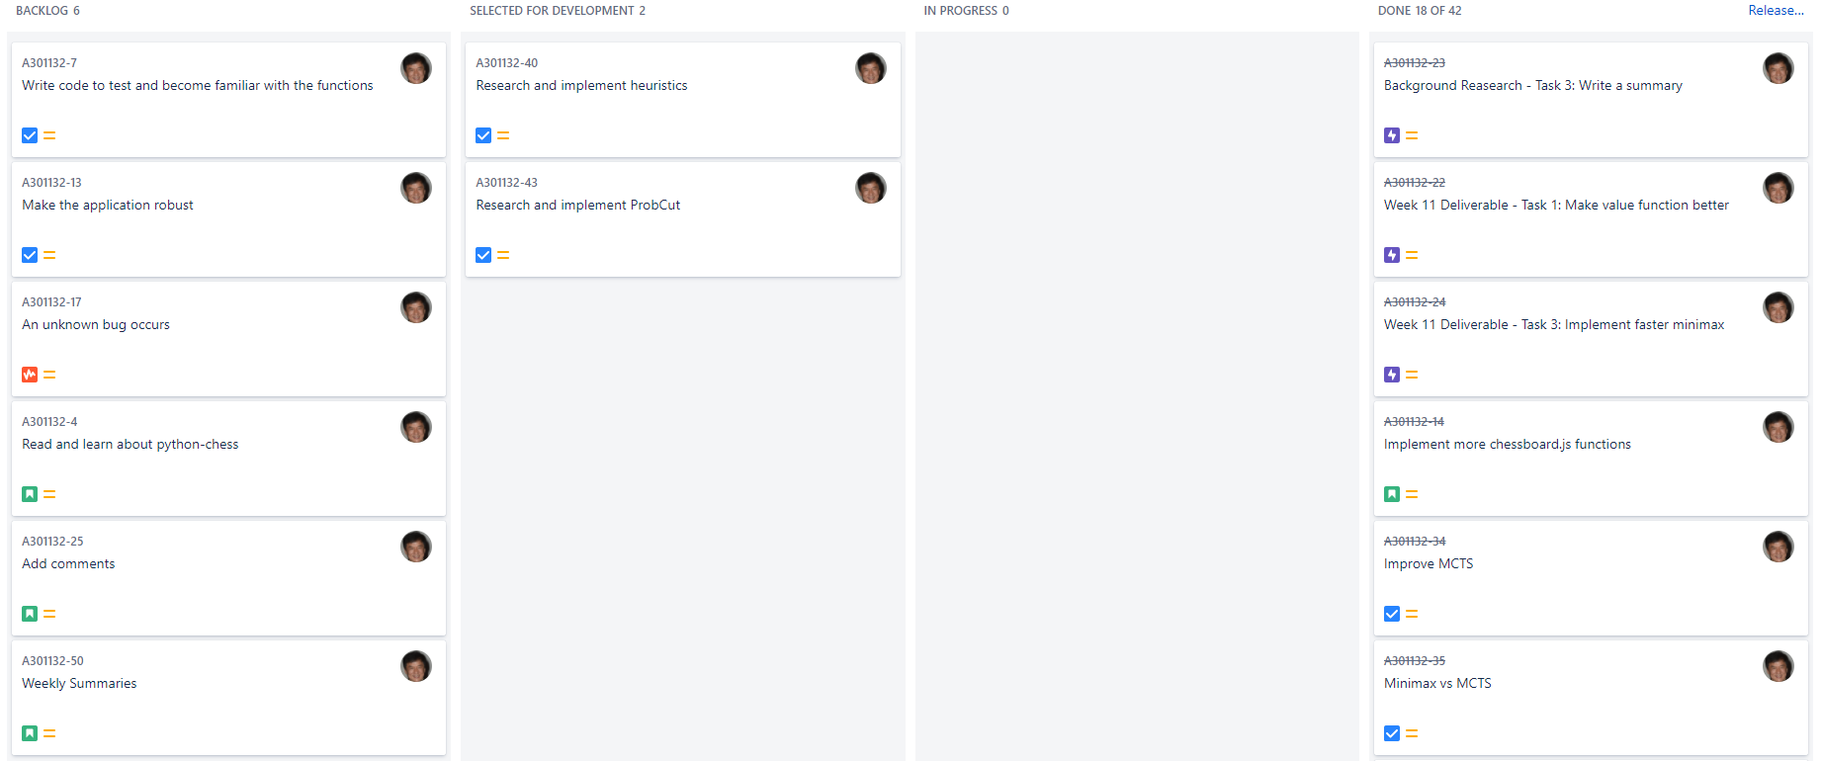
Jira – Kanban Board

Slide 7
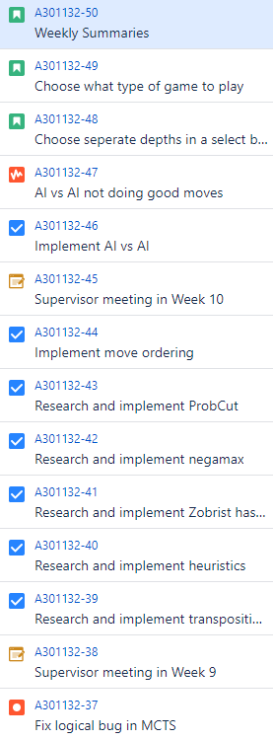
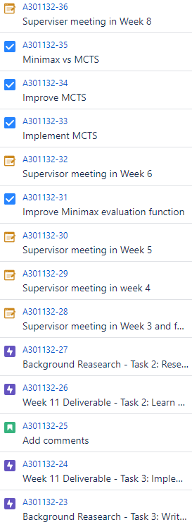
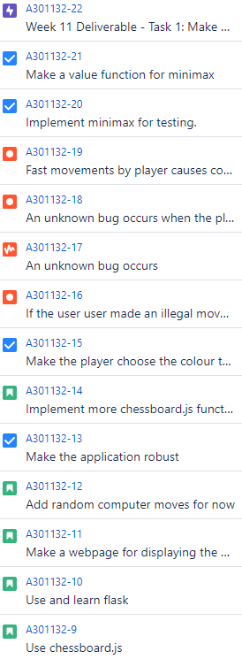
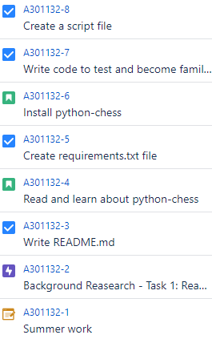
Jira – Issues

Slide 8
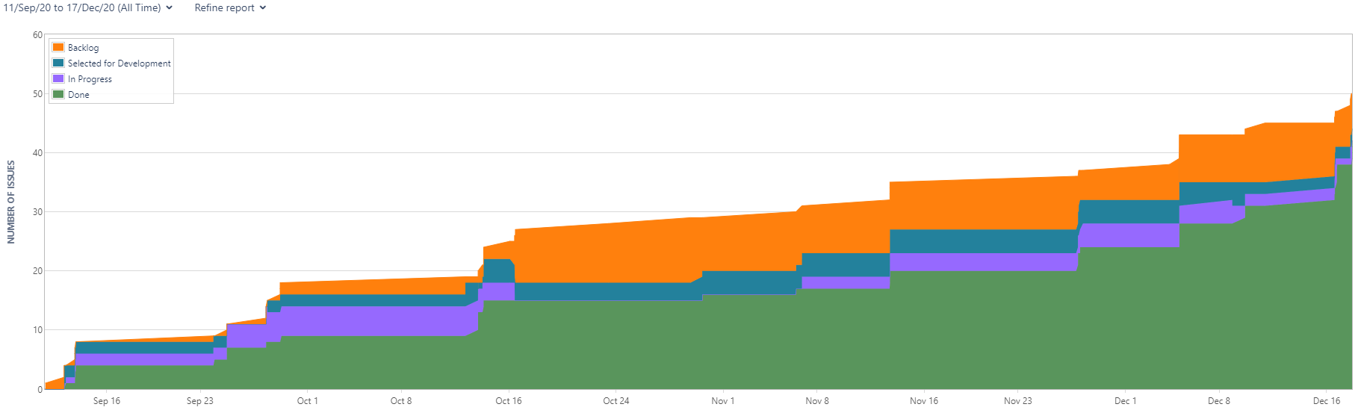
Jira – Cumulative Flow Diagram

Slide 9
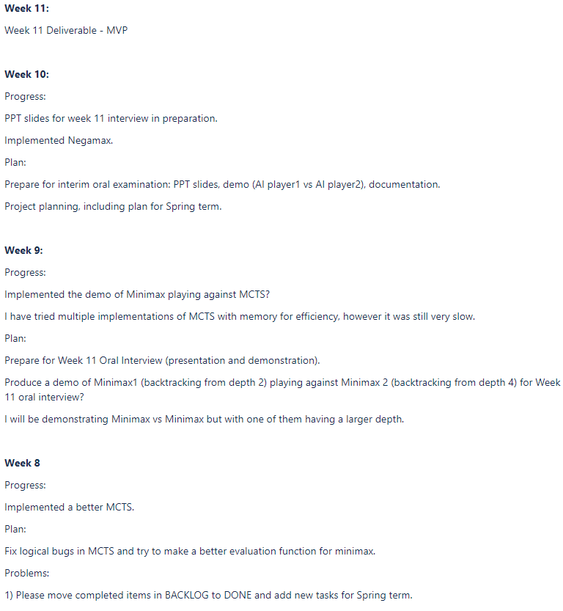
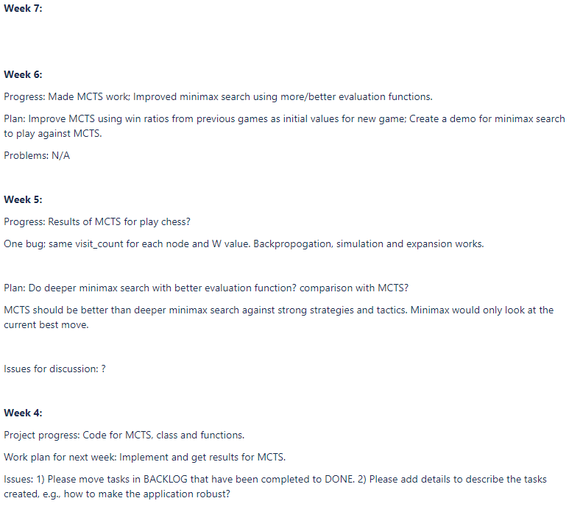
Jira – Weekly Summaries

Slide 10
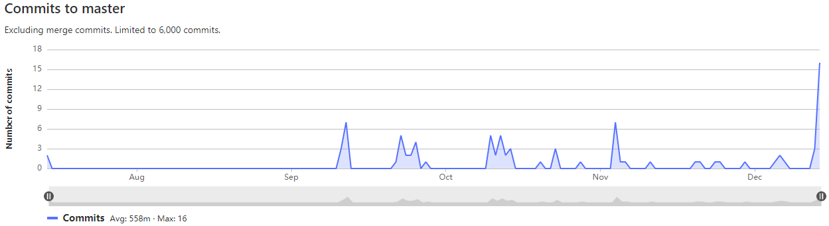
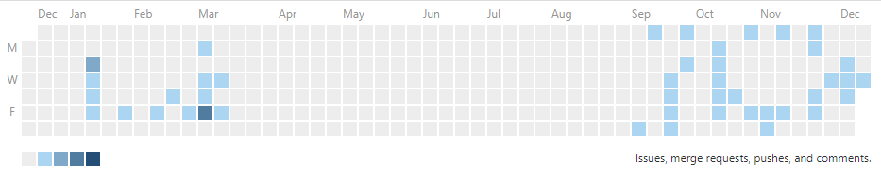
GitLab - Graphs

Slide 11
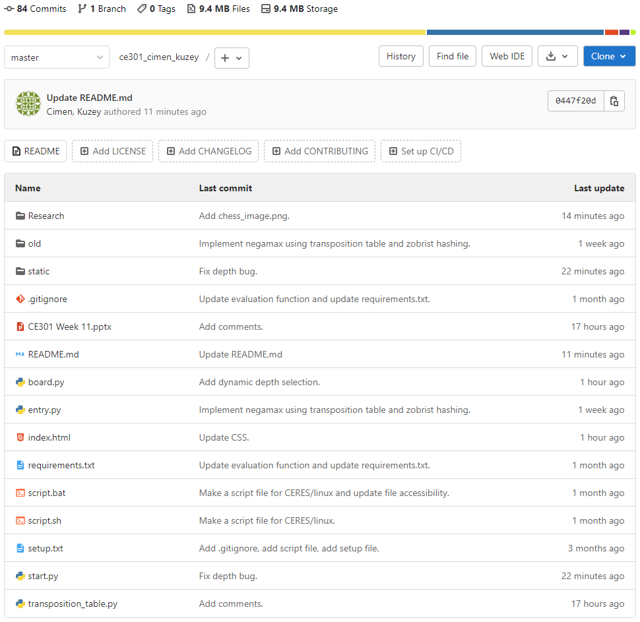
GitLab – Main Page

Slide 12
Future
Make application more robust.
Make it more user friendly (HCI, UX).
Research and Implement Machine Learning Models.
Implement more efficiency methods (Heuristics, ProbCut, etc.).
Improve evaluation function.
Difficulty selection.
Account creation.
Maybe attend Chess AI Competitions.
Taken pieces shown on the website.
How many points behind the current board state
Use OpenAI Gym/Tensorflow/Keras/Pytorch

Slide 13
Questions

